Slide 1
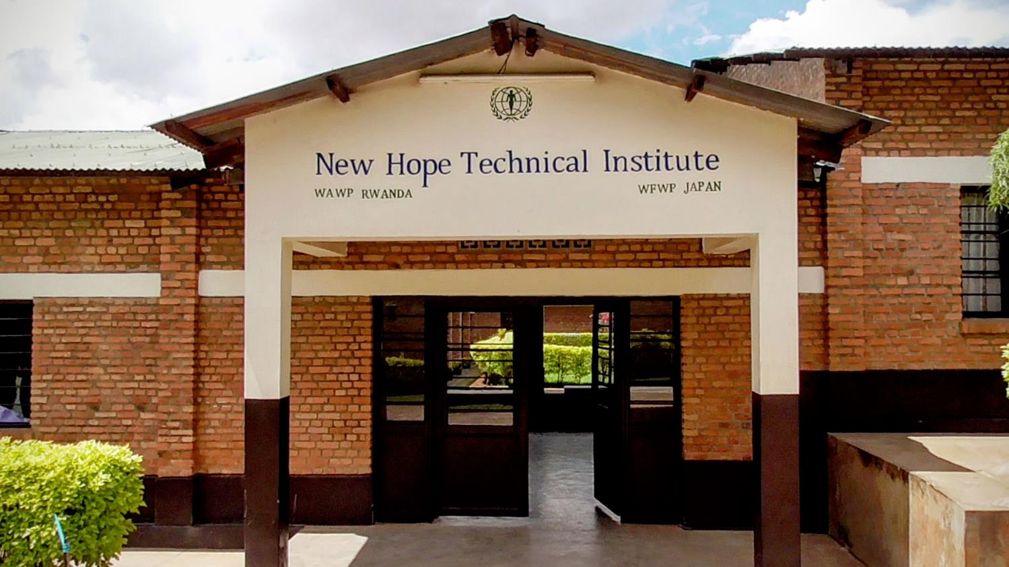
Rwanda : New Hope Technical Institute

Slide 2
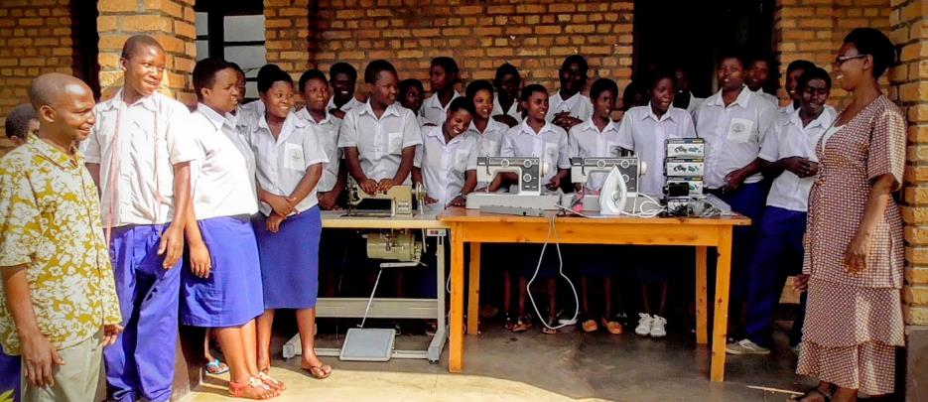
Donation we got from WFWPUSA
Dressmaking course
★Machines of serger, colonnerie and boutonniere.
★Motor of original sewing machine.
★ Iron.

Slide 3
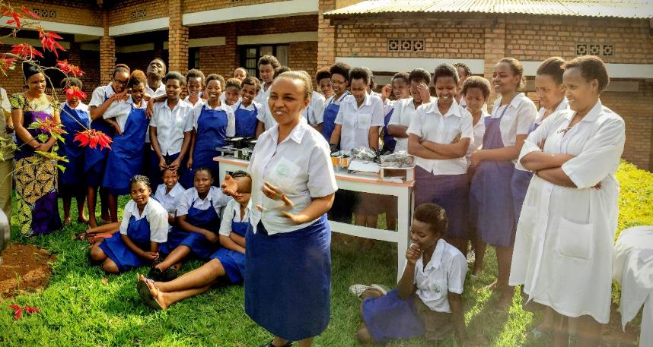
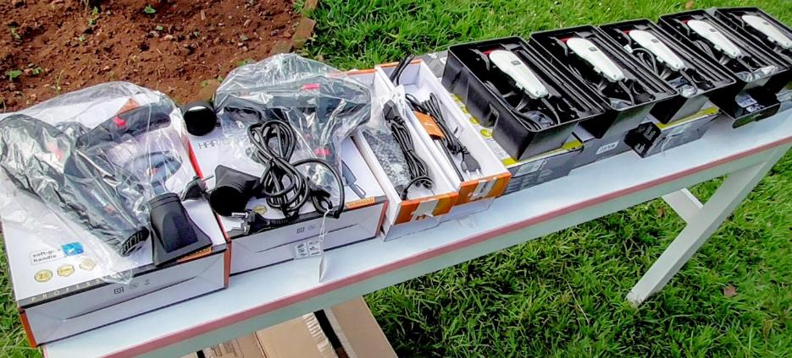
Hairdressing course
Donation we got from WFWPUSA
★Tondeuses
★Hair Flat
★Dryers
★Nippers

Slide 4
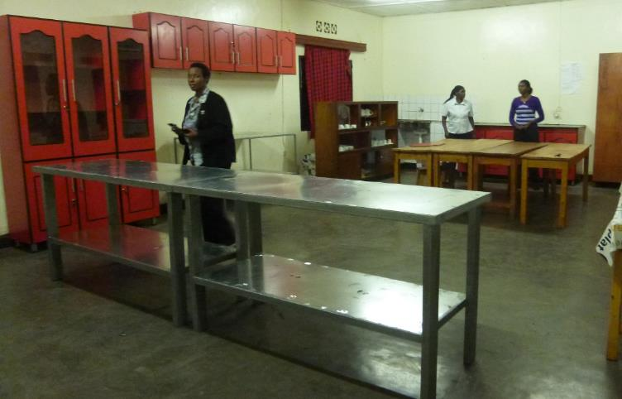
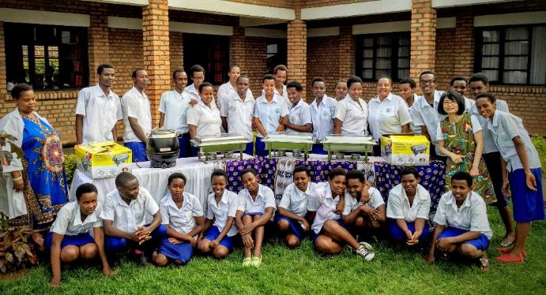
Donation we got from WFWPUSA
cooking course
★Heat Insulating container
★Metric table
★Cupboard

Slide 5
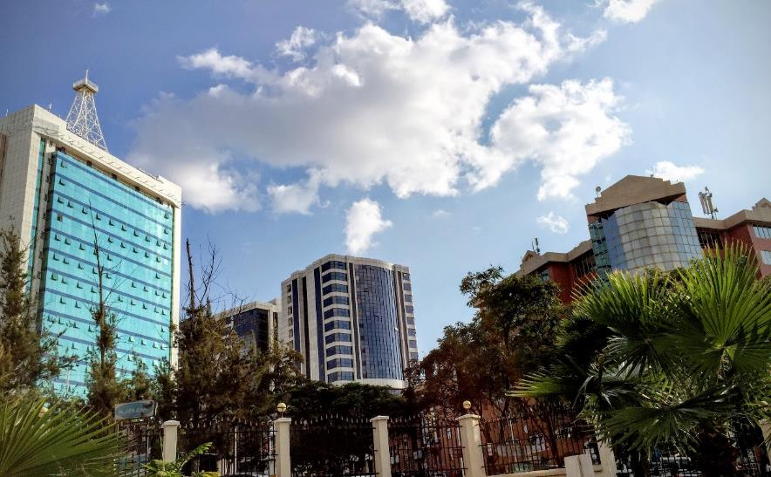
Kigali down town
Near the school

Slide 6
Front of the school

Slide 7
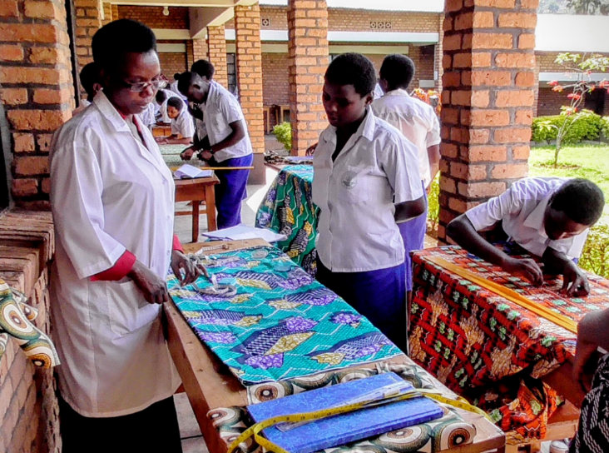
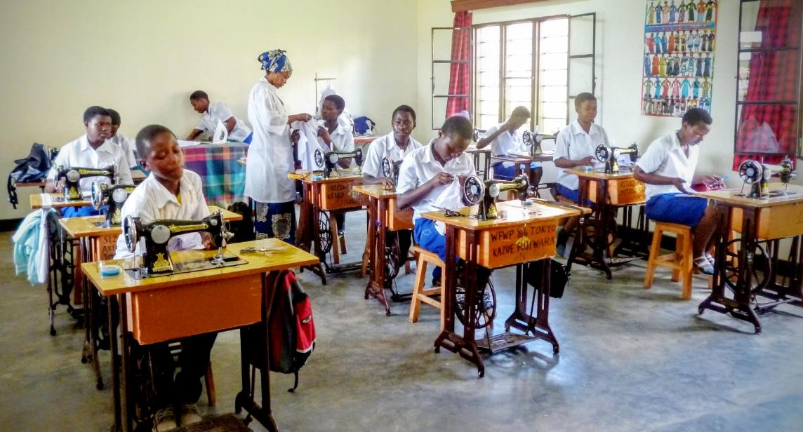
地図
Dressmaking course

Slide 8
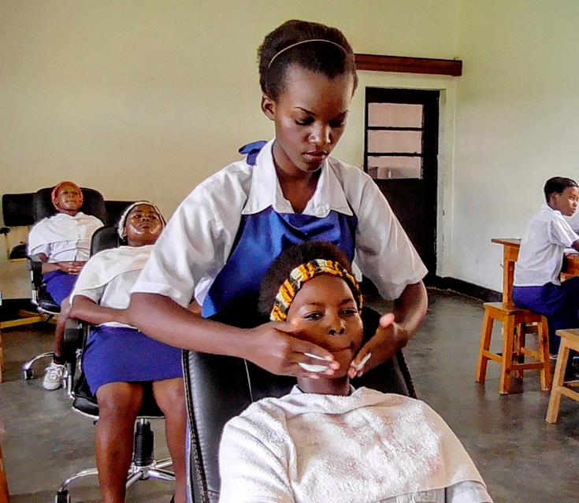
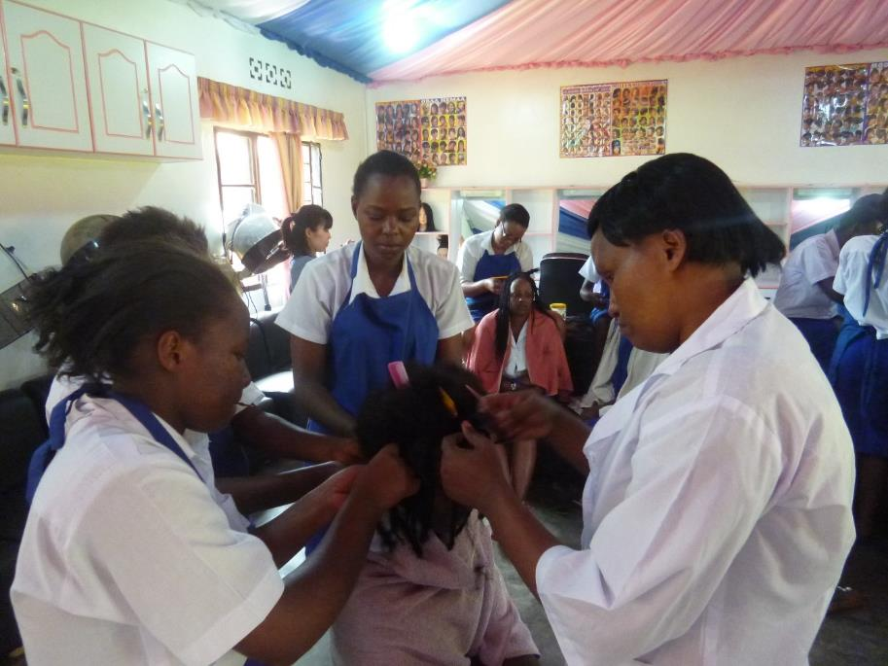
Hair dressing course

Slide 9
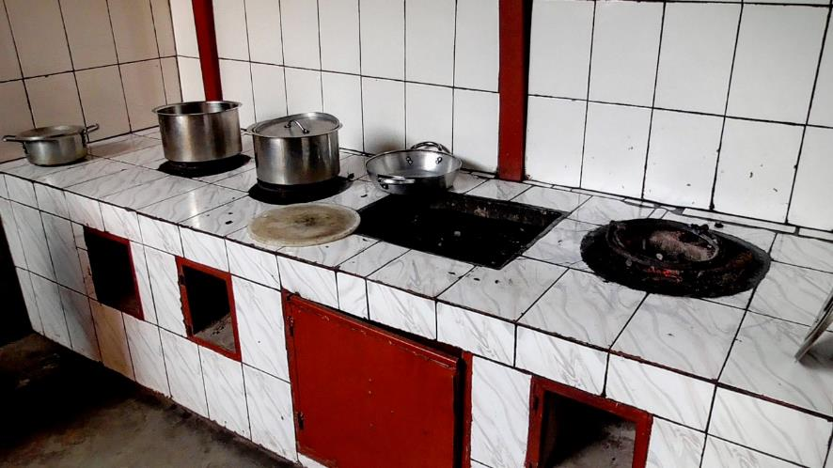
Grill table
Cooking course

Slide 10
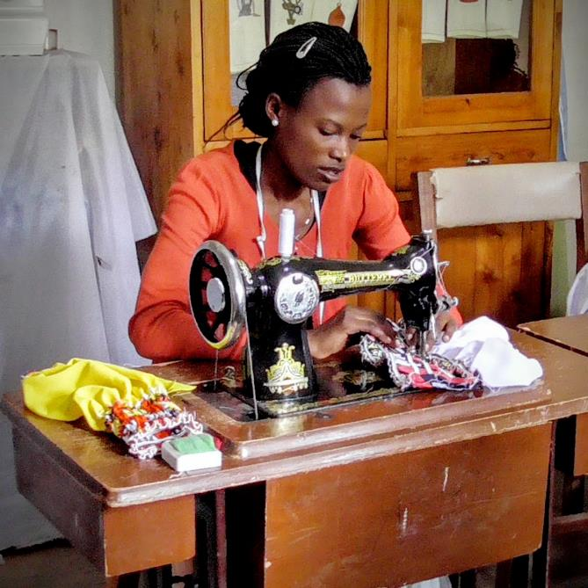
Studio of dressmaking

Slide 11
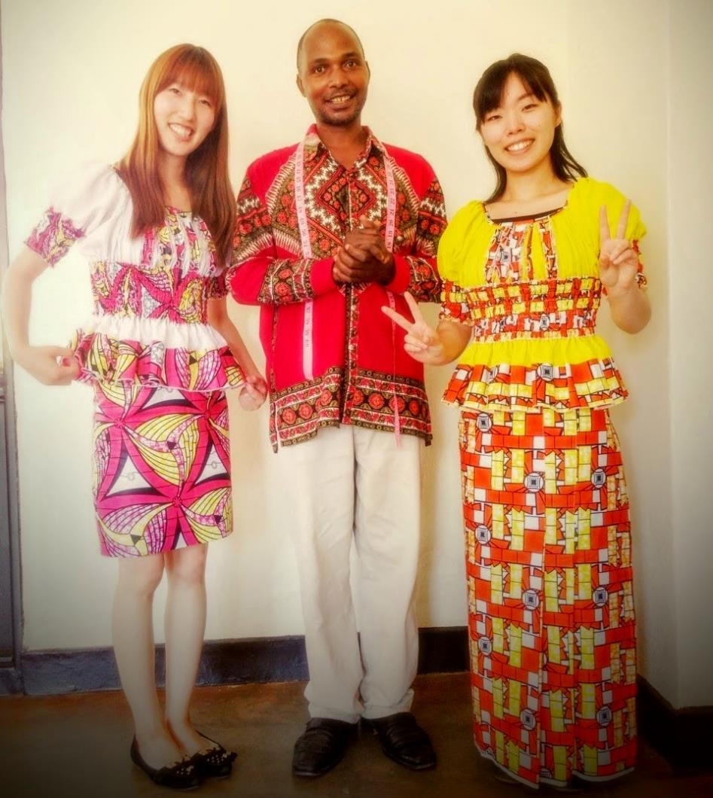
Production of the studio

Slide 12
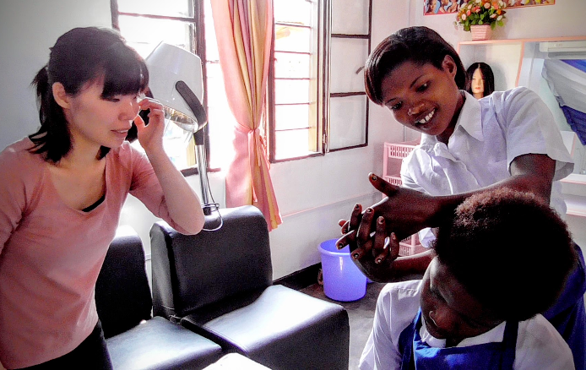
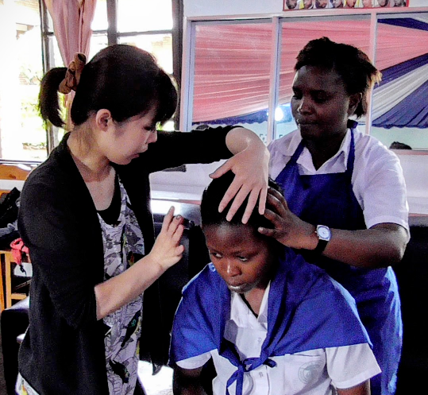
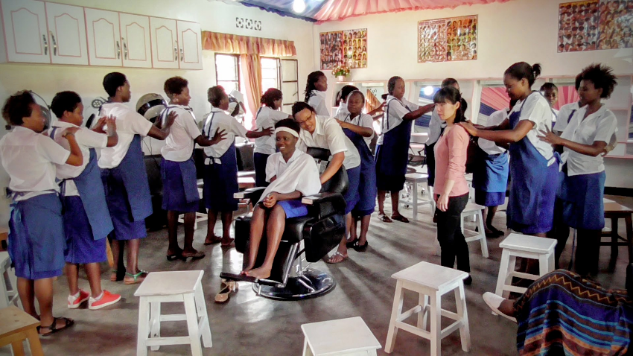
Youth volunteer from Japan, Ms.Haruna Tanaka
teaching of new program of massage skill

Slide 13
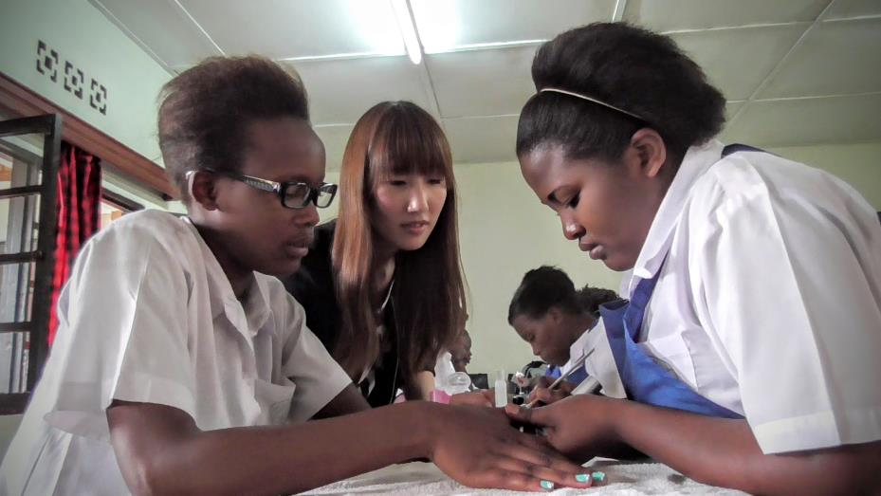
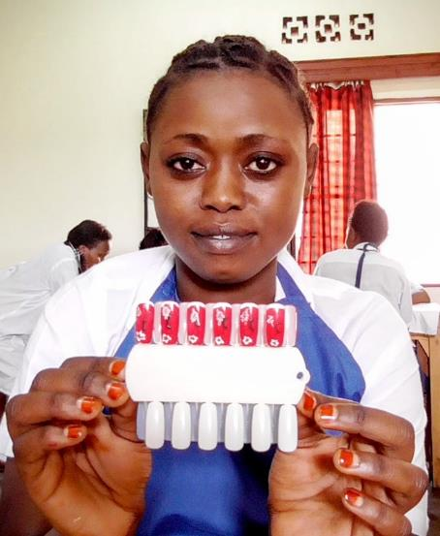
Youth volunteer from Japan, Ms. Minori Tanaka teaching of new program of nailing skill

Slide 14
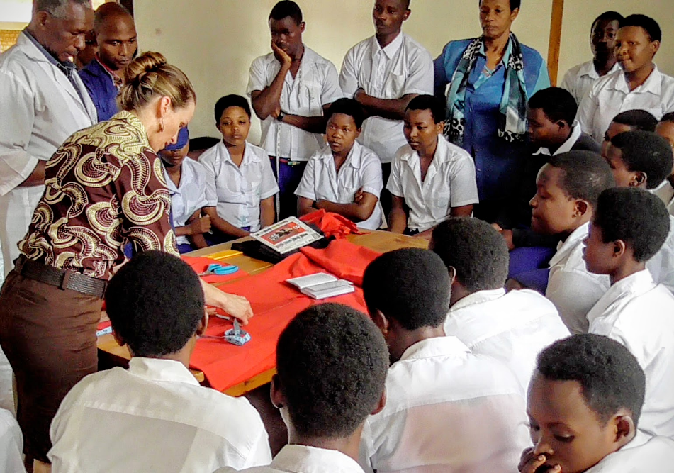
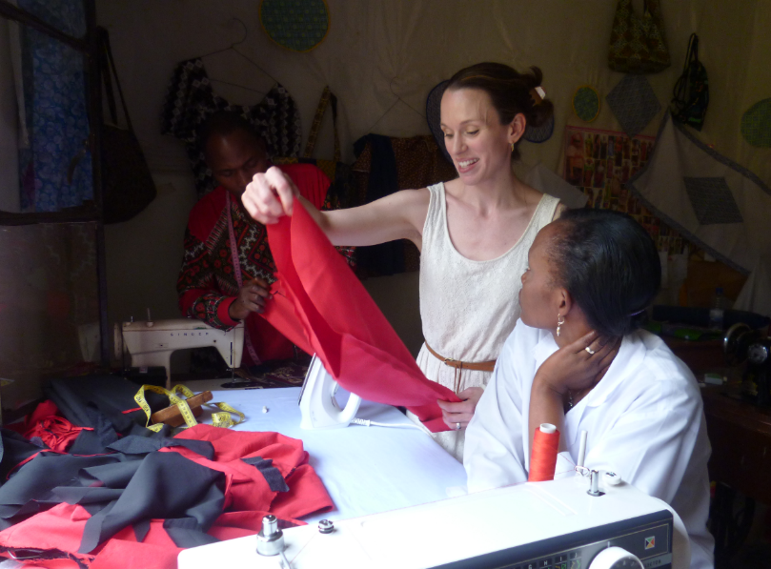
Mrs. Johanne St. Louis, introduced by WFWP Canada, devoting voluntary work for 5 years in Rwanda by teaching dressmaking skills.
She came to teach our school as well.

Slide 15
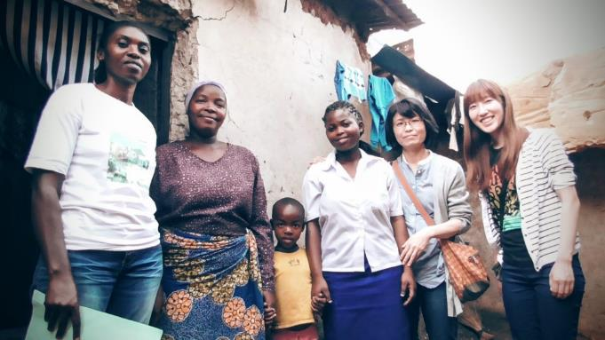
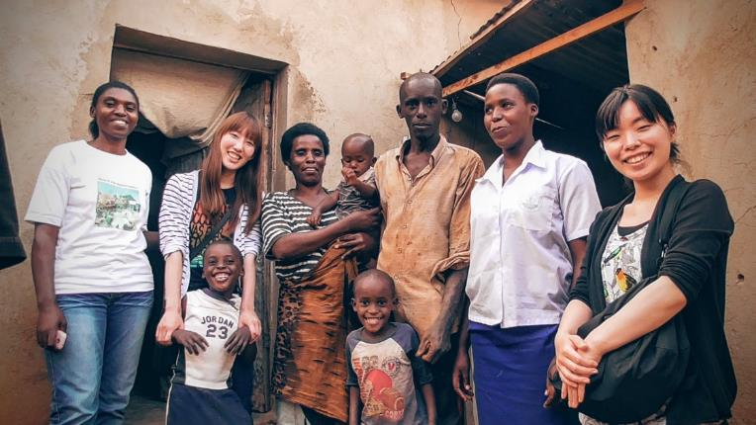
Visit foster children

Slide 16
With Vice-President of Lower House, we gave our activity reports.

Slide 17
Thank you very much for your supports.

